Slide 1

Getting Started with Windows Azure
Cloud Computing Soup to Nuts
Mike Benkovich
Microsoft Corporation
www.benkoTips.com - @mbenko
btlod-70

Slide 2
Today…
What is the Cloud
How to get the tools
Create an account
Build & test a site
Deploy

Slide 3
Software challenges today
$$$
Datacenter peak load
Usage
Idle time
Jan
Apr
Jul
Oct

Slide 4



What is the cloud?
An approach to computing that’s about internet scale
and connecting to a variety of devices and endpoints

Slide 5


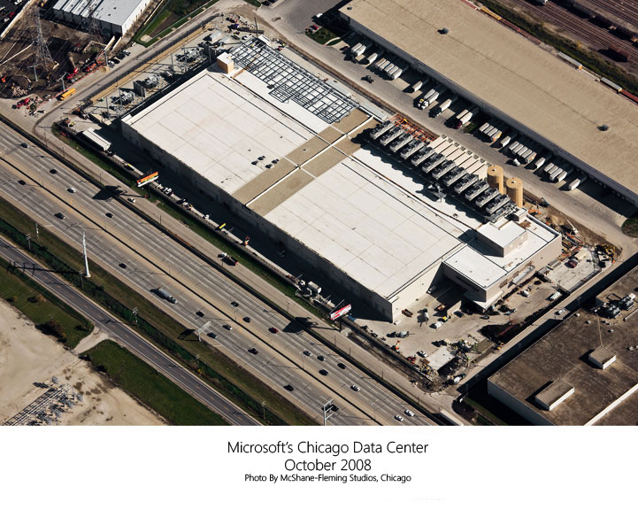
Data Center Abstraction
Ultimately cloud is collection of hardware in Data Centers
Racks, Routers, Blades
  Compute
  Storage
  Networking
Azure Fabric enforces constraints for SLA
  Highly Available
  Redundant
  Performant

Slide 6
Windows Azure
Compute
Storage
Database
Core Services
Additional Services
Caching
CDN
Service Bus
Reporting
Data Sync
Azure Connect
Identity
HPC

Slide 7
Windows Azure Consumption Prices
Windows Azure
SQL Azure
  Elastic, scalable, secure, and highly available
  automated service platform
  Highly available, scalable, and self managed
  distributed database service
  Compute
  Storage
0MB < 100MB | Flat $4.99
100MB < 1GB | Flat $9.99
1GB < 10GB | $9.99 first GB, additional $3.95/GB
10GB < 50GB | $45.95 first 10 GB, additional $1.99/GB
50GB < 150GB | $125.87 for first 50 GB, $0.99/GB
Per service hour
Per GB stored and transactions
$0.02-0.96/hour
+ Variable Instance Sizes
$0.125 GB/month
$0.01/10k transactions
Per database/month. No transaction costs. Bandwidth extra.
Windows Azure Additional Services
  Caching
  Access Control
  Service Bus
128MB cache for $45/month
$0.01 per 10,000 messages
$0.10 per 100 relay hours
Per Message Operation
Per Message Operation
$1.99/100k transactions
Prices shown in USD only. International prices are available

Slide 8
Windows Azure Instance Sizes
  Variable instance sizes to handle complex workloads of any size
  Extra Small
  Small
  Medium
  Large
  X-Large
$0.04
$0.12
$0.24
$0.48
$0.96
Per service hour
Per service hour
Per service hour
Per service hour
Per service hour
  Unit of Compute Defined
  Extra Small
  Small
  Medium
  Large
  X-Large
1 x 1.0Ghz
1 x 1.6Ghz
2 x 1.6Ghz
4 x 1.6Ghz
8 x 1.6Ghz
(low IO)
(moderate IO)
(high IO)
(high IO)
(high IO)
1.75 GB memory
3.5 GB memory
7.0 GB memory
14 GB memory
768 MB memory
20 GB storage
(instance storage)
250 GB storage
(instance storage)
500 GB storage
(instance storage)
1000 GB storage
(instance storage)
2000 GB
(instance storage)

Slide 9

Why Cloud
Reduce operations cost
Leverage Efficiencies of Scale
Speed to Market
Disposable Computing
Scalability
Global Presence

Slide 10


Windows Azure Scenarios
Ideal for Applications Needing:
  Scalability
  Availability
  Fault Tolerance
Common Application Uses:
  Web Sites
  Compute Intensive apps
  Device Applications
  Web APIs
  Social Games

Slide 11
Getting Started
3 Month Free Trial
MSDN Subscription Benefits
INCLUDES THESE CORE COMPONENTS:
BENEFITS INCLUDE:
Free Windows Azure access for Professional, Premium, and ultimate subscribers
Designed to accelerate development
Requires credit card at sign-up any overages beyond free allocation
Compute
Storage
Transactions
Bandwidth
Databases
Caching
Access Control
Service Bus
Go to http://aka.ms/AzureTrialMB

Slide 12
Windows Azure MSDN Benefits
 | Ultimate | Premium | Professional
Compute | 1500 hrs of small instances | 1500 hrs of x-small instances | 750 hrs of x-small instances
Storage | 30GB | 25GB | 20GB
Transactions | 2M | 1M | 250K
Bandwidth | 35GB out / free in | 30GB out / free in | 25GB out / free in
Databases | 5GB Web Edition | 1GB Web Edition | 1GB Web Edition
Caching | 128MB cache | 128MB cache | 128MB cache
Access Control | 500K | 200K | 100K
Service Bus | 5 connections | 5 connections | 2 connections
Go to http://bit.ly/bqtAzMSDN

Slide 13
Get Started my subscriptions
demo

Slide 14
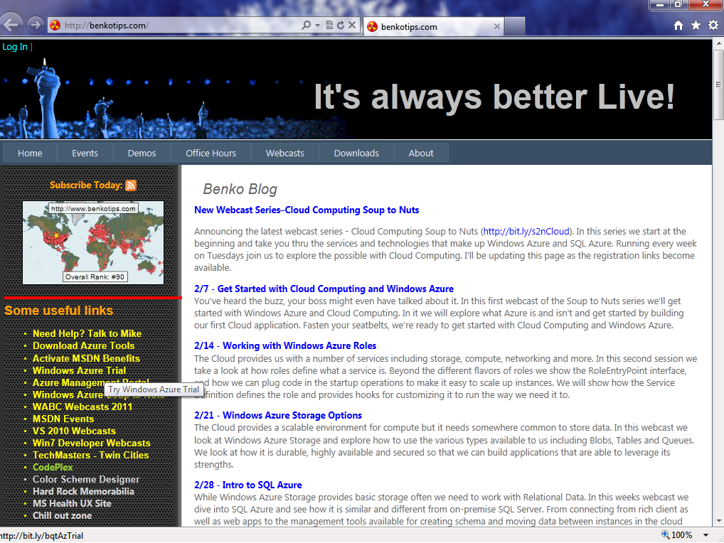

Slide 15
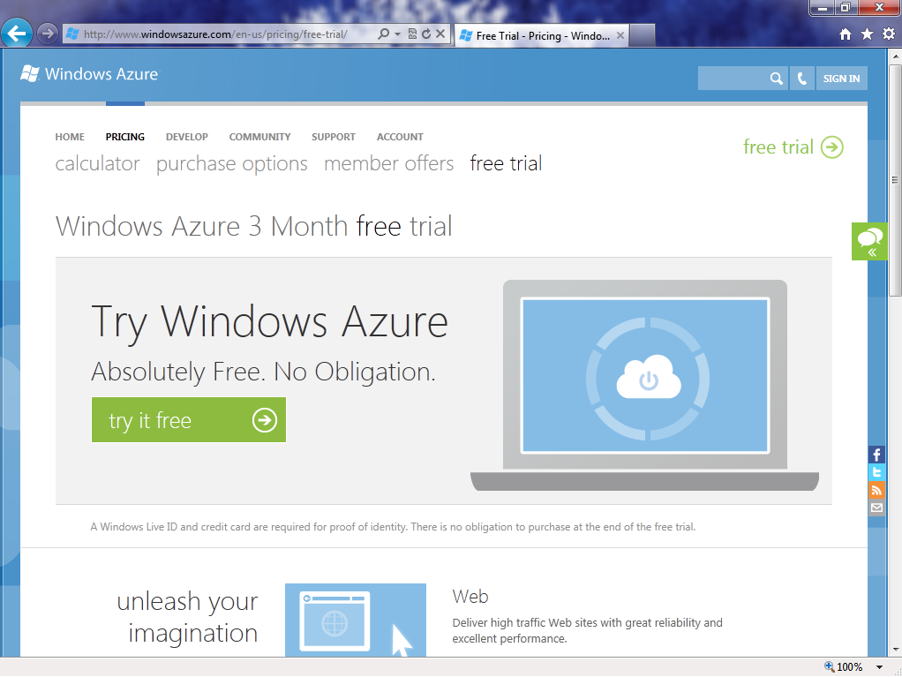

Slide 16
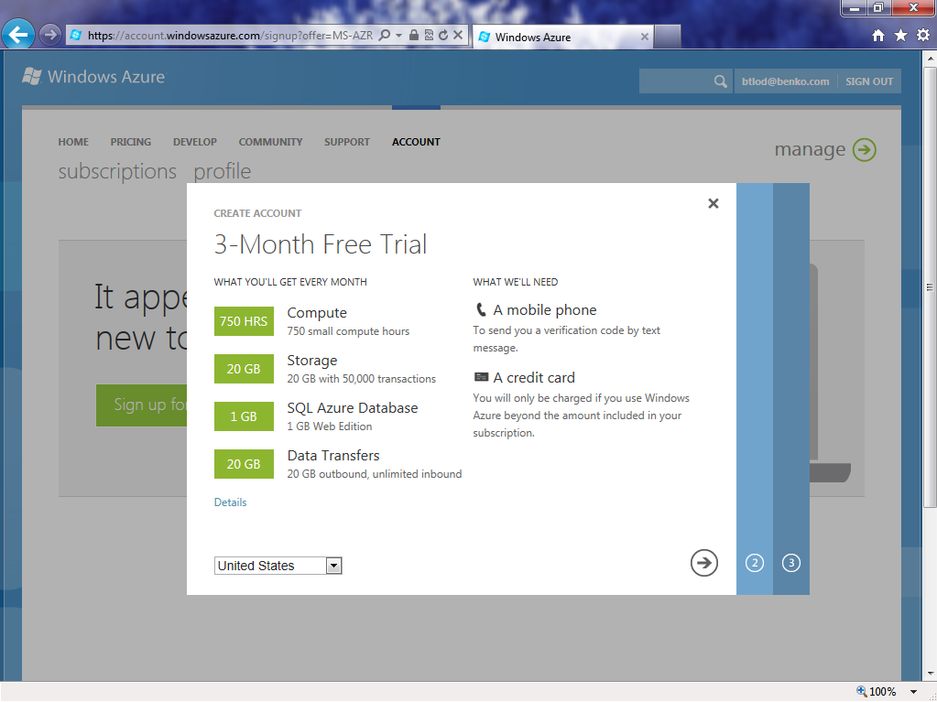

Slide 17
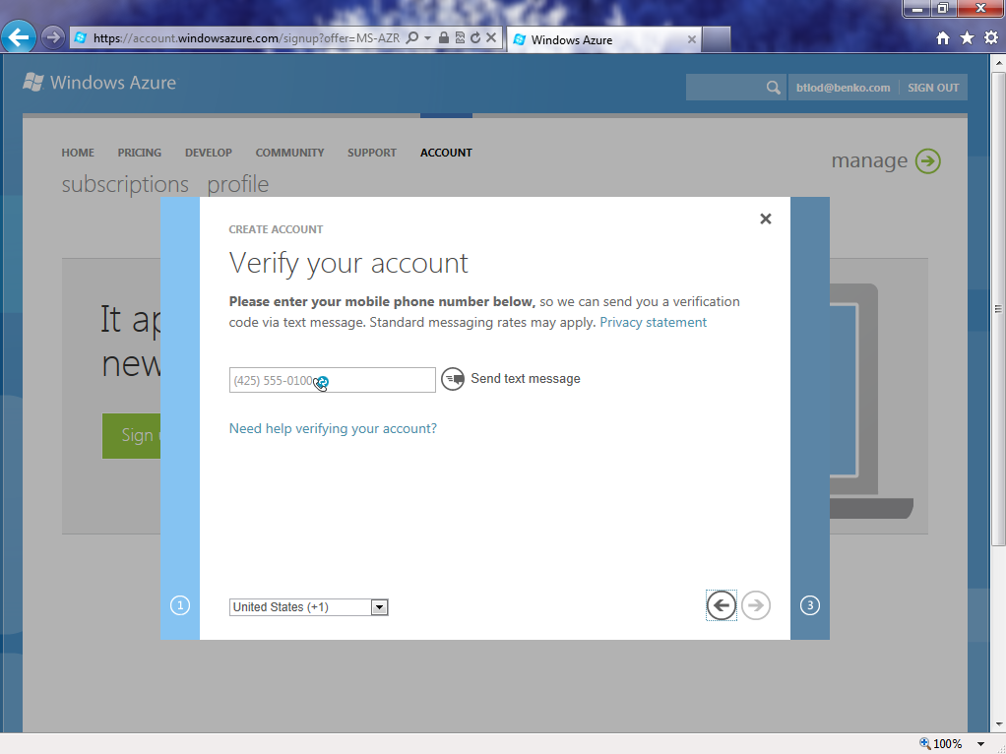

Slide 18
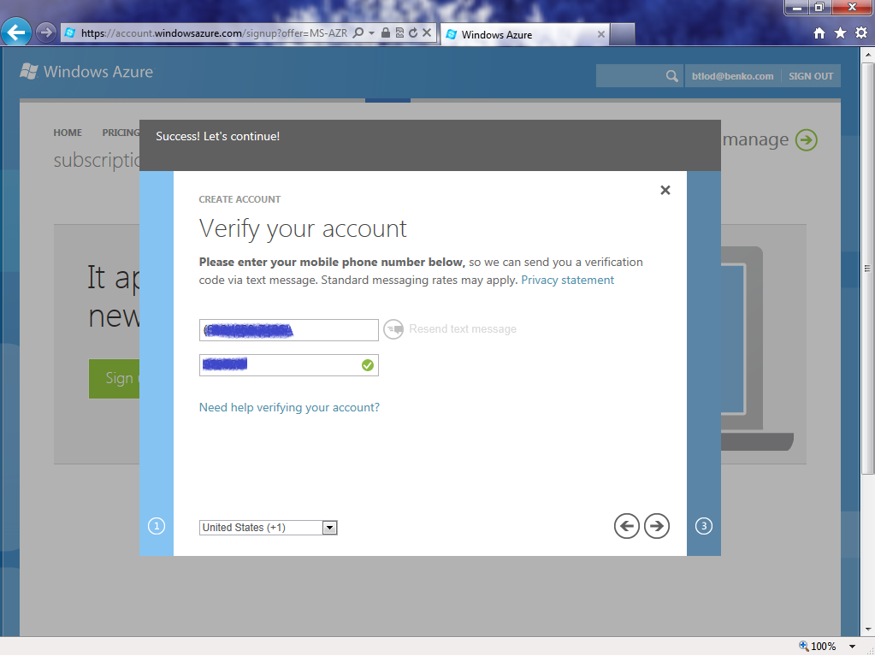

Slide 19
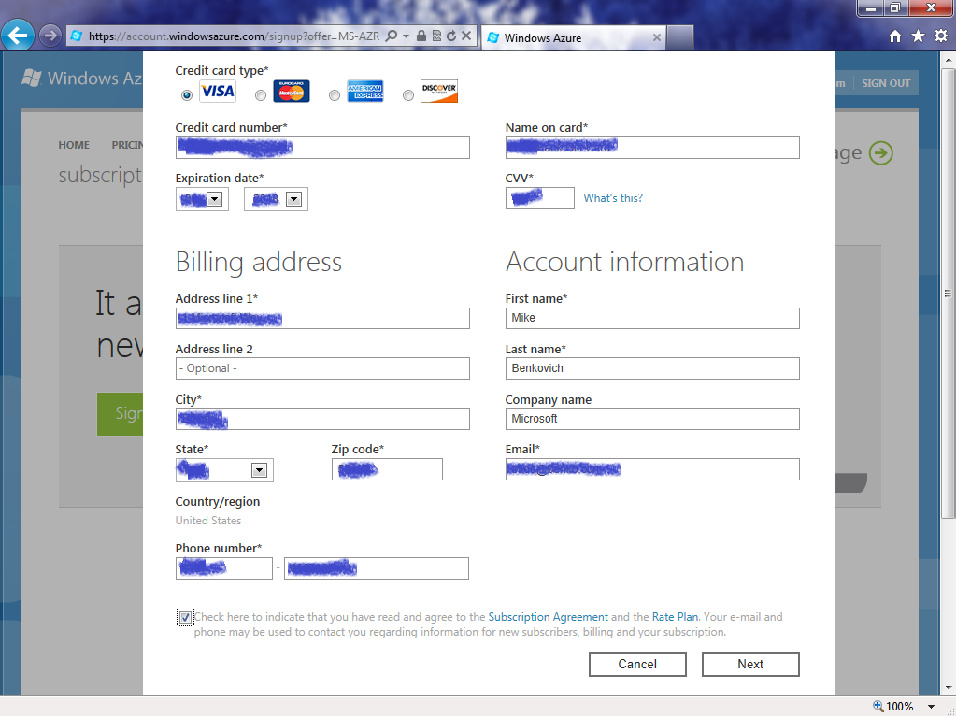

Slide 20
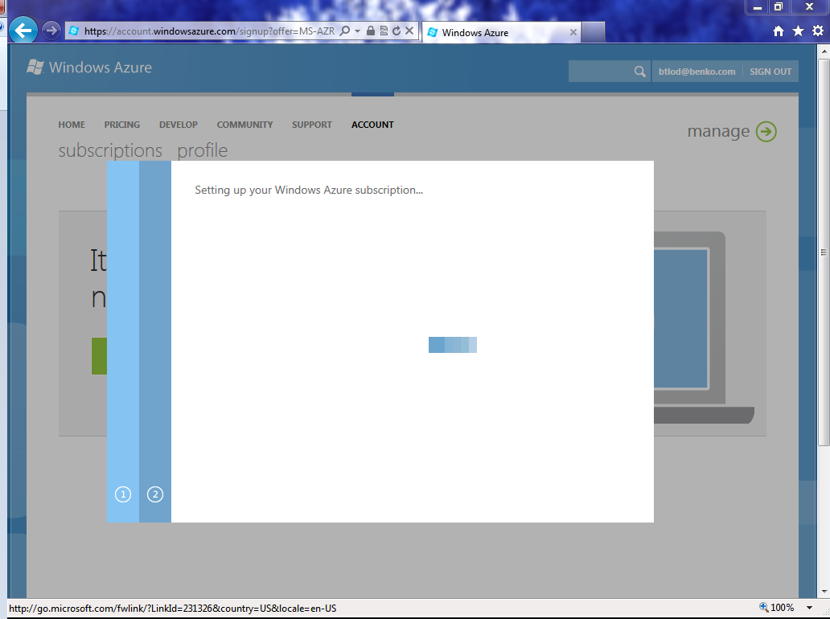

Slide 21
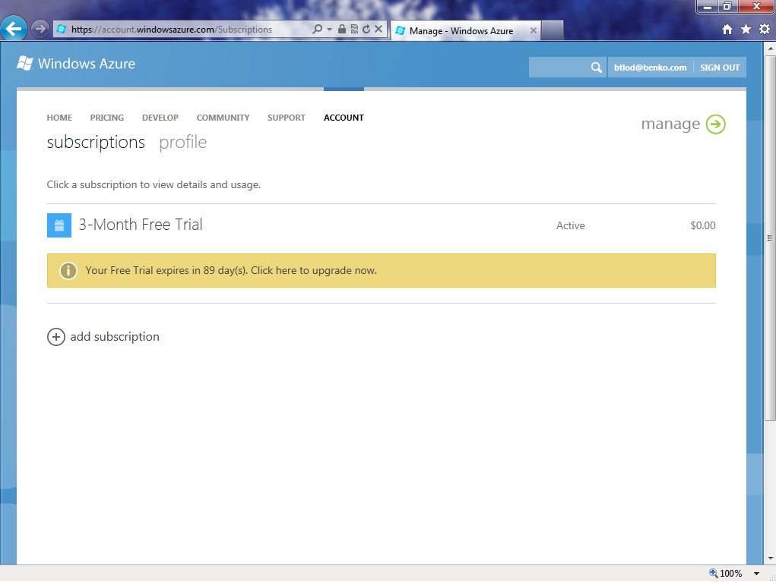

Slide 22
Get Started my subscriptions
demo

Slide 23
Windows Azure Tools
Pick an environment:
  Visual Studio 2010
  PowerShell
  Eclipse
  cmd shell
Pick a platform:
  .net
  node.js
  java
  php
  other
Go to http://aka.ms/AzureMB

Slide 24
Get Started
Tools
demo

Slide 25
Build/Migrate an App
Green field…
  Application templates
  Debug local
  Publish to cloud
Brown field…
  Add Cloud Deployment Implement WebRole.cs
  Add References
  - Diagnostics
  - Service Runtime
  - StorageClient

Slide 26
Get Started build & deploy
demo

Slide 27
Management of your App
Deployments
  Configuration
  Remote desktop
  Instance count
  VIP swap
  User accounts
Services
  Windows Azure Storage
  SQL Azure
  Reporting
  Services
  Connect
  Traffic Manager

Slide 28
Get Started management
demo

Slide 29
We covered…
+What is the Cloud
+How to get the tools
+Create an account
+Build & test a site
+Deploy

Slide 30
Summary
Windows Azure enables us to work with Microsoft’s Data Centers, provisioning Compute, Storage and Databases easily and quickly
Accounts can take the form of Benefits, Trials and Pay as you Go
Tools are available to fit your developer needs
Building and deploying to the cloud is fast and easy with the tools and thru the web

Slide 31
Where can I get more info?
Visit my site http://www.benkotips.com
  Resources from today’s talk
  Webcasts
  Downloads
Check out the rest of this series!
  http://bit.ly/s2nCloud
Ask questions on Windows Azure Office Hours
  http://bit.ly/bqtWazOH
Get the Tools & the Trial
  http://aka.ms/AzureMB
  http://aka.ms/AzureTrialMB

Slide 33

Listen to Past Events
Download recordings by going to the
archives on
http://www.benkotips.com/OfficeHrs
Links to specific shows
11/11 with Michael Wood http://bit.ly/WazOh-1
11/18 with Adam Grocholski http://bit.ly/WazOH-2
12/2 with Azure MVP’s http://bit.ly/WazOH-3
12/9 with Paul Stubbs http://bit.ly/WazOH-4
12/16 with Mark Russinovich http://bit.ly/WazOH-5
1/20 with Scott Klein http://bit.ly/WazOH-7
1/27 with Mike Collier http://bit.ly/WazOH-8

