Slide 1
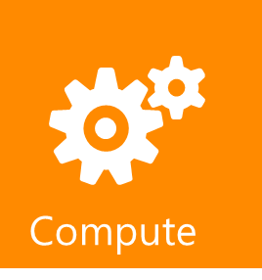
Windows Azure Role
Cloud Computing Soup to Nuts
Mike Benkovich
Microsoft Corporation
www.benkoTips.com - @mbenko
btlod-71

Slide 2
Session Objectives and Takeaways
Describe Windows Azure Compute
Understand Model and Terminology
Understand role customization, scalability and upgrade

Slide 3

Windows Azure
Windows Azure is Microsoft’s Cloud Platform for Developers
Operating System
for the Cloud
  Runs applications in the cloud
  Provides Storage
  Application Management
Windows Azure ideal for
applications needing:
  Scalability
  Availability
  Fault Tolerance
  On-Demand Computing
  Performance
Notes:
This should be a recap as this session will dig deeper into the services.

Slide 4
Windows Azure
Compute
Storage
Database
Core Services
Additional Services
Caching
CDN
Service Bus
Reporting
Data Sync
Azure Connect
Identity
HPC
Notes:
Speaking Points:
3 core services: Compute, Storage, Database
Let’s take a look at the platform starting with the core services.
Compute:
Scalable environment for running code
Enables .NET, C++, PHP, Ruby, Python, …
Automated service management
Storage:
Scalable and highly available cloud storage
Blobs, Tables, Queues, Drives
REST APIs and several client libraries
Database:
SQL Relational Database
Familiar programming model & tools
--
Speaking Points:
I suspect most if not all of you in this room are familiar with the Windows Azure today.
Today the platform consists of a set of foundational services
SQL Azure relational database
AppFabric provides services that can be used by any apps – hosted in Windows Azure, on-premises, or hosted in another environment.
Questions:
How many of you are building applications for Windows Azure?
How many are using SQL Azure?
How many are using the Access Control service today? The Service Bus?
Notes:
Windows Azure Story
We are building an open platform to run your applications in the cloud. Your apps are .NET, Java, PHP, etc. We love everyone.
We are going to help you migrate your existing apps to the cloud.
The cloud platform is the future. Enables scale, self-service, lowers friction, etc. We provide the best cloud platform for building new apps. (aka n-tier, web services, etc.)

Slide 5
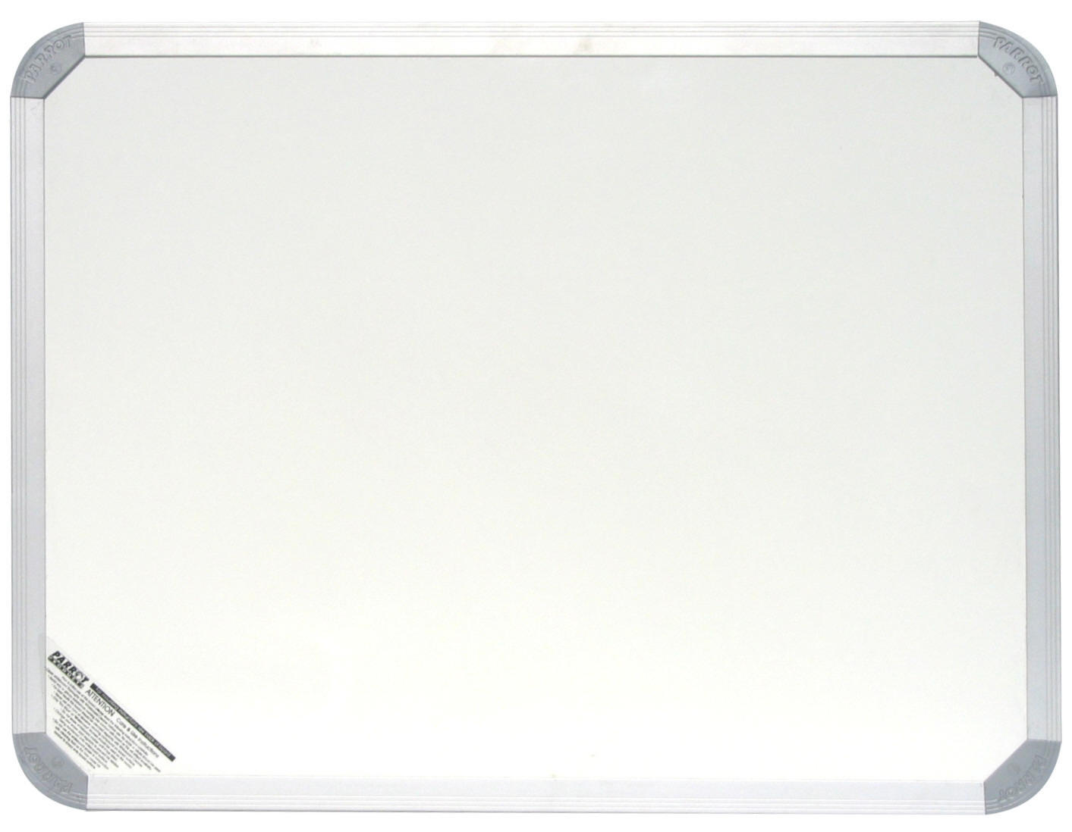
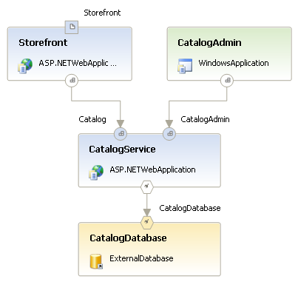
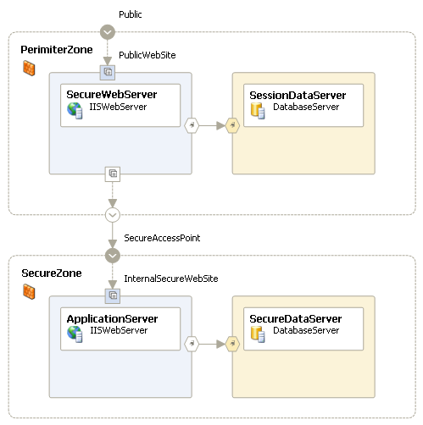
Service Model Whiteboard
Front-End
Middle-Tier
Windows
Azure
Storage,
SQL Azure
HTTP/HTTPS
Middle-Tier
Load Balancer
Front-End
Middle-Tier
Mark’s Cloud Application

Slide 6
Azure Compute
Service Definition
demo

Slide 7
Service Definition
Mike’s Service
Definition:
  Role name
  Role type
  VM size (e.g. small, medium...)
  Network endpoints
Code:
  Web/Worker Role: Hosted DLL
  and other executables
  VM Role: VHD
Configuration:
  Number of instances
  Number of update and fault domains
Role: Front-End
Definition
Type: Web
VM Size: Small
Endpoints: External-1
Role: Middle-Tier
Definition
Type: Worker
VM Size: Large
Endpoints: Internal-1
Configuration
Instances: 2
Update Domains: 2
Fault Domains: 2
Configuration
Instances: 3
Update Domains: 2
Fault Domains: 2

Slide 8


The Fabric Controller (FC)
The “kernel” of the cloud operating system
  Manages datacenter hardware
  Manages Windows Azure services
Four main responsibilities:
  Datacenter resource allocation
  Datacenter resource
  provisioning
  Service lifecycle management
  Service health management
Inputs:
  Description of the hardware and network resources it will control
  Service model and binaries for cloud applications
Server
Kernel
Process
Datacenter
Fabric Controller
Service
Word
SQL Server
Exchange
Online
SQL Azure
Windows Kernel
Fabric Controller
Server
Datacenter

Slide 9
Example Service Allocation
Role A
Count: 3
Update Domains: 2
Fault Domains: 2
Size: Large
Role B
Count: 2
Update Domains: 2
Fault Domains: 2
Size: Medium
www.mycloudapp.net
www.mycloudapp.net
Load
Balancer
10.100.0.36
10.100.0.185
10.100.0.122
Fault Domain 1
Fault Domain 2
Fault Domain 3

Slide 10
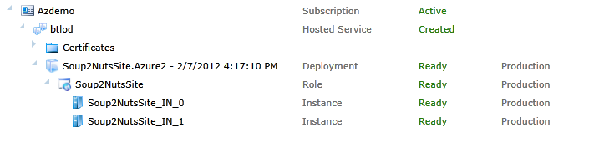
Some terminology…
+ Subscription - unit of billing, associated with Live ID
  + Hosted Service - dns name reservation
    - Certificates - used for deployment
    + Deployments - 2 slots, Production & Staging
      + Roles - defines types of instances to be created
        Instances - has a size and an instance count

Slide 11
VM Size in Windows Azure
Windows Azure
  Supports Various VM Sizes
  Size set on Role in Service Definition - All instances of role will be of equal size
  Service can have multiple roles
  Balance of Performance per node vs. High Availability from multiple nodes
Size | CPU Cores | RAM | Local Storage | Cost (USD)
Extra Small | Shared | 768M | 20GB | .04
Small | 1 | 1.7GB | 250GB | .12
Medium | 2 | 3.5GB | 500GB | .24
Large | 4 | 7GB | 1000GB | .48
Extra large | 8 | 15GB | 2000GB | .96
Notes:
Slide Objective
To understand how and why to change the VM Size for a Windows Azure role
Slide Notes
When you create your service model, you can specify the size of the virtual machine (VM) to which to deploy instances of your role, depending on its resource requirements.
The size of the VM determines
the number of CPU cores
the memory capacity
the local file system size allocated to a running instance
Each physical machine in Windows Azure contains 8 processor cores. You need to specify an XL instance to reserve an entire machine
Network is shared but burstable
Can burst beyond your 1/8th allocation when using a small VM
May be limited to just your allocation
For guaranteed high network throughput use an XL VM
Not
http://msdn.microsoft.com/en-us/library/ee814754.aspxes

Slide 12
What is Windows Azure Compute?
Virtual Machines in the Cloud
Three Flavors:
Web Role
Worker Role
VM Role

Slide 13
Web Role
All features of a worker role + IIS 7 or 7.5
ASP.NET 3.5 SP1 or 4.0 – 64bit
Hosts
  Webforms or MVC
  FastCGI applications (e.g. PHP)
  Multiple Websites
Http(s)
Web/Worker Hybrid
  Can optionally implement RoleEntryPoint
Notes:
Slide Objective
Understand how a Web Role extends the standard worker role
Speaker Notes
A web role takes all the capabilities and semantics of a worker role and adds the IIS Hostable Web Core
Web Roles run ASP.NET websites- they do this by using the IIS hostage web core.
pretty much anything that will work in a standard IIS ASP.NET Web Site should work in Windows Azure. At MIX09, we additionally added support for IIS7’s FastCGI capability. As a note, any files that are part of a asp.net project on windows azure are READ ONLY! If you need to be able to change the contents of files:
User Blob Storage
If its configuration, use the service model files – which can be changed at runtime.
Inbound protocols are http(s) – outbound protocols are any TCP connection but NOT UDP.
Notes
http://msdn.microsoft.com/en-us/library/dd179341.aspx
http://blogs.msdn.com/b/carlosag/archive/2008/04/14/hostyourownwebserverusingiis7.aspx
http://blogs.iis.net/ksingla/archive/2007/12/20/ins-amp-outs-of-hostable-web-core.aspx

Slide 14
Worker Role
Queue Polling Worker
  Poll and Pop Messages within while(true) loop
  E.g. Map/Reduce pattern, background image processing
Listening Worker Role
  Create TcpListener or WCF Service Host
  E.g. Run a .NET SMTP server or WCF Service
External Process Worker Role
  OnStart or Run method executes Process.Start()
  Startup Task installs or executes background/foreground process
  Custom Role Entry Point (executable or .Net assembly)
  E.g. Run a database server, web server, distributed cache
Notes:
Slide Objective
Understand the 3 common patterns of worker roles
Speaker Notes
Pattern 1 – Polling
Worker role polls a Queue
Pops message
Performs work
Polls queue again
Pattern 2
Worker listens for inbound TCP request
Can implement with Raw TcpListeners or use WCF or use Hosted Web Core
Pattern 3
Run a 3rd party process
When the role starts up or runs use a Process.Start() call to run a standard windows executable
E.g. Running a database server
Notes
http://blog.smarx.com/posts/build-your-own-web-role-running-hosted-web-core-in-windows-azure
http://blog.smarx.com/posts/making-songs-swing-with-windows-azure-python-and-the-echo-nest-api

Slide 15
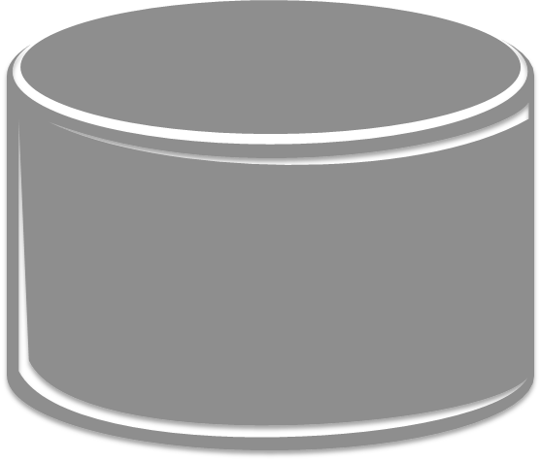
Windows Azure Service Architecture
The Internet via TCP or HTTP
Windows Azure Data Center
LB
LB
LB
Storage
Web Role
IIS as Host
Queues
Web Role
Managed Interface Call
Tables
Blobs
Notes:
Slide Objective
Understand at a high level how the Windows Azure Platform maps into the high scale archetype
Speaker Notes
Key points here are
that all external connections come through a load balancer THIS INCLUDES STORAGE.
If you are familiar with the previous model, you will notice that two new features are diagrammed here as well, namely inter-role communication (notice there is no load balancer) and TCP ports directly to Worker Roles (or Web Roles).
We will still use the storage to communicate async and reliably via queues for a lot of options.
However, inter-role communication fills in when you need direct synchronous comm.
The load balancers are a key to Windows Azure.

Slide 16
What Can It Run?
General Rule
  If it runs in Windows it runs in Windows Azure
Choice of Language
  C#, VB, C++, Java, PHP, Ruby, Node.js, Phython, etc.
Choice of Frameworks
  .NET, ExpressJS, Rails, Zend, etc.

Slide 17
Service Configuration
Supplies Runtime Values
(Scale, Config Settings, Certificates to use, VHD, etc.)
Can be updated any time through Portal or API

Slide 18
Service Configuration
<?xml version="1.0"?>
<ServiceConfiguration serviceName="WebDeploy" xmlns="http://schemas.microsoft.com/serviceHosting/2008/10ServiceConfiguration">
<Role name="Webux">
<Instances count="1"/>
<ConfigurationSettings>
<Setting name="DiagnosticsConnectionString" value="UseDevelopmentStorage=true/>
<Setting name="Microsoft.WindowsAzure.plugins.RemoteAccess.Enabled" value="True"/>
<Setting name="Microsoft.WindowsAzure.plugins.RemoteAccess.AccountUsername" value="dunnry"/>
<Setting name="Microsoft.WindowsAzure.plugins.RemoteAccess.AccountEncryptedPassword" value="MIIBrAYJKoZIhvcNAQcDoIIB"/>
<Setting name="Microsoft.WindowsAzure.plugins.RemoteAccess.AccountExpiration" value="2010-12-23T23:59:59.0000000-07"/>
<Setting name="Microsoft.Windows Azure.Plugins.RemoteForwarder.Enabled" value="True"/>
<ConfigurationSettings>
<Certificate>
<Certificates name="Microsoft.WindowsAzure.Plugins.remoteAccess.PasswordEncryption" thumbprint="D6BE55AC439FAC6CBEBAF"/>
</Certificate>
</Role>
</ServiceConfiguration>

Slide 19
Service Definition
Describes the shape of your
Windows Azure Service
  Defines Roles, Ports, Certificates, Configuration Settings,
  Startup Tasks, IIS Configuration, and more…
Can only be changed by upgrades
or new deployments

Slide 20
Service Definition
<?xml version="1.0" encoding="utf-8"?>
<ServiceDefinition name="WebDeploy" xmlns="http://schemas.microsoft.com/ServiceHosting/2008/10/ServiceDefinition">
  <WebRole name="WebUX">
    <Startup>
      <Task commandLine="..\Startup\EnableWebAdmin.cmd" executionContext="elevated" taskType="simple" />
    </Startup>
    <Imports>
      <Import moduleName="RemoteAccess" />
      <Import moduleName="RemoteForwarder"/>
    </Imports>
    <Sites>
      <Site name="Web">
        <Bindings>
        <Binding name="HttpIn" endpointName="HttpIn"/>
        </Bindings>
      </Site>
    </Sites>
    <Endpoints>
      <InputEndpoint name="HttpIn" protocol="http" port="80"/>
      <InputEndpoint name="mgmtsvc" protocol="tcp" port="8172" localPort="8712"/>
    </Endpoints>

Slide 21
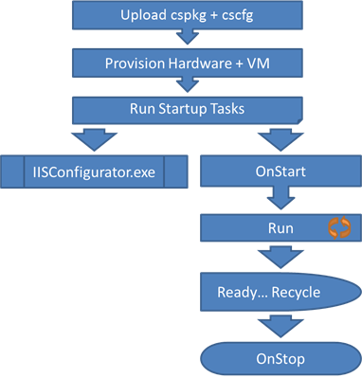
Startup tasks and imports
Startup Tasks
  Runs before RoleEntryPoint OnStart()
  Can run as elevated or standard user
Imports
Package up startup commands into a
reusable format
Stored in the sdk installation directory
Real World Windows Azure Guidance - Corey Fowler @SyntaxC4
http://msdn.microsoft.com/en-us/library/windowsazure/hh127476.aspx

Slide 22
Role Programming Model
Inherits RoleEntryPoint
OnStart() Method
  Called by Fabric on startup, allows you to perform initialization tasks.
  Reports Busy status to load balancer until you return true.
Run()
Method
  Main logic is here – can do anything, typically infinite loop. Should never exit.
OnStop() Method
  Called when role is to be shutdown, graceful exit.
  30 Seconds to tidy up.
Notes:
Slide Objective
Understand the role programming model in overview
Speaker Notes
A role is similar to a windows service. It gets started once deployed, and will get stopped when required.
It could get stopped because
we are re-deploying you to a different server
You actioned the stop from the web-portal
It’s up to you to keep running and NEVER return from Start() unless you have been told to stop. Note: you do not need to handle the stop – you can simply “fail”
Notes
http://msdn.microsoft.com/en-us/library/ee848065.aspx
http://blogs.msdn.com/b/jnak/archive/2010/02/11/windows-azure-roleentrypoint-method-call-order.aspxes

Slide 23
Role Lifecycle
All roles may extend RoleEntryPoint
Roles report status via RoleEnvironment
Methods
Events
Status
Fabric Calls
OnStart
StatusCheck
Busy
Requests Routed
Run
StatusCheck
Ready
Role Lifetime
OnStop
StatusCheck
Busy
Stopping
Notes:
Slide Objective
Understand the lifecycle of a Windows Azure role
Understand the methods that can be overridden in RoleEntryPoint
Understand the events that are raised by role instances when their status is changing
Speaker Notes
Roles will typically extend RoleEntryPoint
The fabric calls RoleEntryPoint methods as it starts and stops a role
WaWorkerHost process is started.
Worker Role assembly is loaded and surfed for a class that derives from RoleEntryPoint. This class is instantiated.
RoleEntryPoint.OnStart() is called.
RoleEntryPoint.Run() is called.
If the RoleEntryPoint.Run() method exits, the RoleEntryPoint.OnStop() method is called .
WaWorkerHost process is stopped. The role will recycle and startup again.
As a role changes state it will raise the StatusCheck event.
A status of Busy will mean the load balancer will not route requests to the instance.
Note
http://blogs.msdn.com/b/jnak/archive/2010/02/11/windows-azure-roleentrypoint-method-call-order.aspx
http://msdn.microsoft.com/en-us/library/ee848065.aspx

Slide 24
Custom Role Entry Points
Run any executable in your role
Not just limited to .Net code
Run custom processes without code
Role automatically restarts if process stops

Slide 25
Custom Role Entry Points
<?xml version="1.0" encoding="utf-8"?>
<ServiceDefinition name="WindowsAzureProject11" xmlns="http://schemas.microsoft.com/ServiceHosting/2008/10/ServiceDefinition">
<WorkerRole name="WorkerRole1" vmsize="Small">
<Runtime executionContext="limited">
<EntryPoint>
<ProgramEntryPoint commandLine="myProcess.exe" setReadyOnProcessStart="true" />
</EntryPoint>
</Runtime>
<Endpoints>
<InputEndpoint name="Endpoint1" protocol="tcp" port="80" />
</Endpoints>
</WorkerRole>
</ServiceDefinition>

Slide 26
Networking in Windows Azure
3 types of Endpoints in Windows Azure
Specify Connectivity Rules in Service Definition
  NetworkTrafficRules
Port Ranges
Local Ports
TCP only
  Input (VIP)
  Internal
  Windows Azure Connect

Slide 27
Local Storage
Role instances have available disk storage
Use LocalStorage element
in service definition
  Name
  CleanOnRoleRecycle
  Size
  Persistent but not guaranteed durable
  Good for cached resources or temporary files
Windows Azure Storage Drives provide
guaranteed durable storage
Notes:
Slide Objective
To introduce the concept of local storage
Speaker Notes
A local storage resource is a reserved directory in the file system of the virtual machine (VM) in which an instance of a role is running.
Code running in the instance can write to the local storage resource when it needs to write to or read from to a file.
For example, a local storage resource can be used as a temporary folder when manipulating data or generating documents.
Local storage is never guaranteed as persistent; CleanOnRoleRecyle = false is useful to minimise need to rebuild cache for example
For guaranteed long term drive based storage- e.g. to hold database files. Use Windows Azure Storage Drives
Notes
http://msdn.microsoft.com/en-us/library/ee758708.aspx

Slide 28
Local Storage
Define in Config
<LocalResources>
<LocalStoragename="myLocalDisk" sizeInMB="10"
cleanOnRoleRecycle="false" />
</LocalResources>
Use in Code
string rootPath = RoleEnvironment.GetLocalResource["myLocalDisk"].RootPath;
DirectoryInfo di = new DirectoryInfo(rootPath);
foreach(di.EnumerateFiles())
….
Notes:
Slide Objective
To show how to implement local storage
Speaker Notes
To declare a local storage resource within the service definition file
add the LocalResources element as a child of a WebRole or WorkerRole element
then add a LocalStorage element to represent the resource.
The LocalStorage element takes three attributes: name, sizeInMB, and cleanOnRoleRecycle.
The sizeInMB attribute specifies the desired size for this local storage resource.
The cleanOnRoleRecycle attribute specifies whether the local storage resource should be wiped clean when a role instance is recycled, or whether it should be persisted across the role lifecycle; the default value is true.
The Windows Azure Managed Library provides classes for accessing the local storage resource from within code running in a role instance. The RoleEnvironment.GetLocalResource method returns a reference to a named LocalResource object.
Because the LocalResource object represents a directory, you can read from it and write to it using the standard .NET file I/O classes. To determine the path to the local storage resource's directory, use the LocalResource.RootPath property
Notes
http://msdn.microsoft.com/en-us/library/ee758708.aspx

Slide 29
Startup Customization
demo

Slide 30
Choosing Your VM Size
Don’t just throw big VMs at every problem
Scale out architectures have natural parallelism
Some scenarios will benefit from more cores
Where moving data >$ parallel overhead
E.g. Video processing, Stateful services (DBMS)
Test various configurations under load
More small instances == more redundancy

Slide 31
Scaling and Upgrading
Scaling options
  Management portal config changes
  PowerShell
  Custom Code
Upgrades
  VIP Swap
  Rolling Upgrades

Slide 32
Configuration Values
Store arbitrary configuration string values
  Define in model
  Populate in configuration
RoleEnvironment
  .GetConfigurationSettingValue()
Don’t use web.config for values you wish
to change at runtime
  App/Web.config is packaged with deployment change requires re-deploy
  *.cscfg supports change tracking and notification to running role instances
Notes:
Slide Objective
Explain Windows Azure specific configuration mechanism
Contrast with web.config
Speaker Notes
The service configuration file specifies the number of role instances to deploy for each role in the service, the values of any configuration settings, and the thumbprints for any certificates associated with a role.
The service configuration file specifies the details of the service deployment, including the number of instances of each role to run, the values for configuration settings defined by the model, and the thumbprints of certificates associated with the service. For more information
Web.config is used today to store configuration for asp.net web sites. Most ASP.NET things still require this, e.g. tracing, security etc.
Web.config cannot be changed once deployed – it’s a static file.
Instead you should store configuration that will change in the ServiceConfiguration files, and use the RoleEnvironment.GetConfigurationSetting method to read the value. Settings in the ServiceConfiguration file can be changed at runtime without restarting the VM!
Will still be times when you just use web.config e.g. System.WebServer settings, adding HttpModules and HttpHandlers etc…
Notes
http://msdn.microsoft.com/en-us/library/ee758710.aspx
http://dunnry.com/blog/2009/04/16/WhyDoesWindowsAzureUseACscfgFile.aspx

Slide 33
Handling Config Changes
RoleEnvironment.Changing
  Occurs before configuration is changed
  Can be cancelled – causes a recycle
RoleEnvironment.Changed
  Occurs after config change has been applied
RoleEnvironmentConfigurationSettingChange
  Provides config value that was changed
RoleEnvironmentTopologyChange
  When role count is changed

Slide 34
Handling Config Changes
Port 80
Http
Port 8090
HTTP
Customer Web Site
Thumbnail Worker
Web Dav
Changed
OnStart
Enumerate
Instances in
WebDav Role
StatusSvc
HTTP
StatusSvc
HTTP
Regular Polling for Status
Regular Polling for Status
73984
83425
Notes:
Slide Objective
To explain the configuration change events in a worked example
Speaker Notes
Worked example is changing the configuration of the WebDav role to run another instance
When the config changes a new instance will start.
We catch the changed event and use that to allow us to re-enumerate the internal endpoints to find an additional endpoint to poll
Notes
http://msdn.microsoft.com/en-us/library/ee848064.aspx

Slide 35
Config Changes
demo

Slide 36
Fault Domains
99.95% Uptime Guarantee
  Requires 2 or more instance per role
Role instance are isolated
by fault domain
  Fault domains isolate VMs
  Fault domains provide redundancy
  At least two fault domains per role
Notes:
The infrastructure of each Windows Azure data center is notionally divided into multiple sections known as fault domains. These sections of the infrastructure (which are not necessarily individual servers or server racks) are designed in such a way that a failure of one fault domain is extremely unlikely to affect any other fault domain. When you deploy a service, the Windows Azure Fabric Controller automatically locates the roles in at least two different fault domains so that a failure in one domain will not affect all instances of your service.

Slide 37
Upgrade Domains
Logical unit, which determines how
particular service will be upgraded
Default number of upgrade domains
that are configured for your application is 5 (five)
You can control how many upgrade domains
your application will use through the

Slide 38
Roles and Instances
Example role with nine virtual machines distributed across three fault domains
Network Load Balancer
Role
Fault Domain 1
Fault Domain 2
Fault Domain 3
VM₁
VM₃
VM₂
VM₄
VM₆
VM₉
VM₅
VM₈
VM₆
VM₉
Notes:
Slide Objective
Understand what a scale-out application looks like
Speaking notes
High scale applications often follow this sort of an pattern
Inbound connectivity comes through a load balancer
Requests are round robin routed
Load balancer is typically aware of the state of the web servers (i.e. are they up)
There are one or more tiers or groups of stateless web or app servers
By stateless we mean that they do not hold state between client requests
Stateless means that simple load balancing works – no need for sticky sessions
Stateless means that the failure of a web server does not cause major issues for application- it is simply removed from the load balancer
A stateful or storage tier
This will generally involve some sort of scale out approach for large apps
Often using partitioned databases
Often some sort of queuing mechanism
Applications will often perform processing in the background.
Improves response time for users
Allows load peaks to be buffered in queues
Windows Azure provides us with a Platform as a Service offering to implement these sorts of applications
Notes
http://msdn.microsoft.com/en-us/magazine/cc500561.aspx
http://msdn.microsoft.com/en-us/library/ff650667.aspx

Slide 39
The High Scale Application Archetype
Windows Azure provides a ‘pay-as-you-go’ scale out application platform
Intelligent Network Load Balancer
Network Activation
Stateless Web and/or Application Servers
Stateless ‘Worker’ Machines
Async Activation
State Tier
Queues
Key/Value
Datastores
Partitioned RDBMS
Shared Filesystem
Notes:
Slide Objective
Understand what a scale-out application looks like
Speaking notes
High scale applications often follow this sort of an pattern
Inbound connectivity comes through a load balancer
Requests are round robin routed
Load balancer is typically aware of the state of the web servers (i.e. are they up)
There are one or more tiers or groups of stateless web or app servers
By stateless we mean that they do not hold state between client requests
Stateless means that simple load balancing works – no need for sticky sessions
Stateless means that the failure of a web server does not cause major issues for application- it is simply removed from the load balancer
A stateful or storage tier
This will generally involve some sort of scale out approach for large apps
Often using partitioned databases
Often some sort of queuing mechanism
Applications will often perform processing in the background.
Improves response time for users
Allows load peaks to be buffered in queues
Windows Azure provides us with a Platform as a Service offering to implement these sorts of applications
Notes
http://msdn.microsoft.com/en-us/magazine/cc500561.aspx
http://msdn.microsoft.com/en-us/library/ff650667.aspx

Slide 40
Upgrading Your Application
VIP Swap:
  Uses Staging and Production environments
  Allows to quickly swap environments
  Production: v1 ↓ Staging: v2, after swap then Production: v2 ↑ Staging: v1
In-Place Upgrade
  Performs a rolling upgrade on live service
  Entire service or a single role
  Manual or Automatic across update domains
  Cannot change Service Model

Slide 41
VIP Swap
Network Load Balancer
Role
Production
Staging
Production
Staging
Package
VM₁
VM₂
VM₁
VM₂
VM₃
VM₄
VM₃
VM₄

Slide 42
Upgrade Options
demo

Slide 43
Summary
Service model defines service shape
Service configuration defines service scale
Selectable VM Sizes
Windows Azure provides specific
configuration capability
  Scale out aware
  Allows event based change subscription
Upgrading and Deployment

Slide 45
Monitoring
Monitoring is not Debugging
Instrument your application using Trace, Debug
  DiagnosticMonitorTraceListener
Use Diagnostics API to Configure and Collect
  Event Logs
  Performance Counters
  Trace/Debug information (logging)
  IIS Logs, Failed Request Logs
  Crash Dumps or Arbitrary files
Request data on demand or scheduled
  Transferred into your table and/or blob storage

