Slide 1
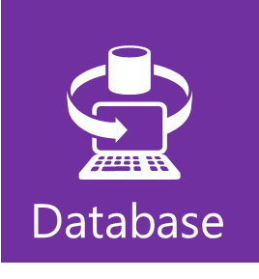
Get Started with SQL Azure
Cloud Computing Soup to Nuts
Mike Benkovich
Microsoft Corporation
www.benkoTips.com - @mbenko
btlod-73

Slide 2
Agenda
Starting with the Basics
Build and Deploy your Database
Secure your Database
Exploring Advanced Capabilities

Slide 3
Windows Azure
Compute
Storage
Database
Core Services
Additional Services
Caching
CDN
Service Bus
Reporting
Data Sync
Azure Connect
Identity
HPC

Slide 4
Starting with
the Basics

Slide 5

Start With the Basics
SQL Azure Database is
  SQL Server database technology delivered as a service
  on the Windows Azure Platform
  Ideal for both simple and complex applications
  Enterprise-ready with automatic support for HA
  Designed to scale out elastically with demand
  Get started quickly
  Choose a plan
  Choose a billing option
  Provision servers
  Ready to get started?
  Let’s jump into development

Slide 6
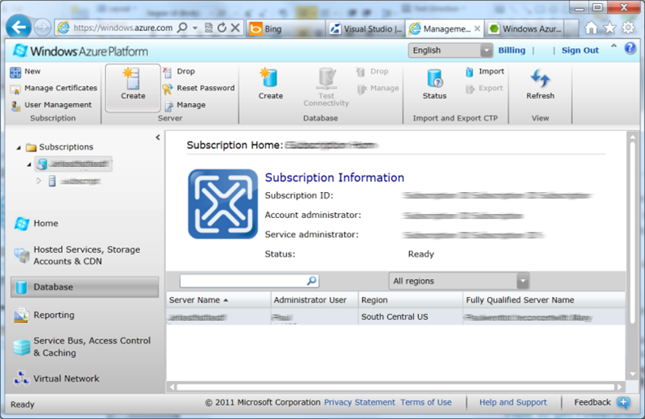
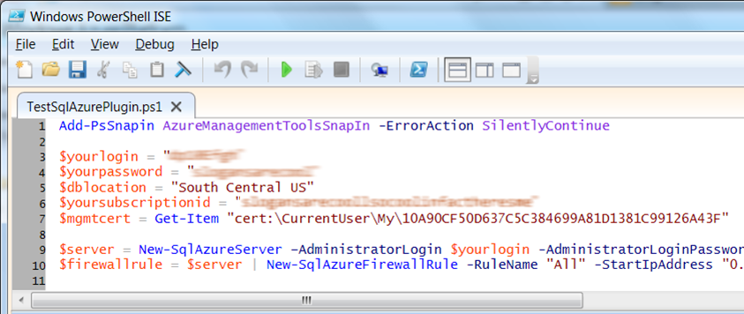
Provision Your Server
Server defined
  Service head that contains databases
  Connect via automatically generated FQDN (xxx.database.windows.net)
  Initially contains only a master database
Provision servers interactively
  Log on to Windows Azure Management Portal
  Create a SQL Azure server
  Specify admin login credentials
  Add firewall rules and enable service access
Automate server provisioning
  Use Windows Azure Platform PowerShell cmdlets
  (or use REST API directly)
  wappowershell.codeplex.com

Slide 7
Creating a SQL Azure DB
demo

Slide 8
Build and Deploy
your Database

Slide 9
Build Your Database
Use familiar technologies
  Supports Transact-SQL
  Supports popular languages
  .NET Framework (C#, Visual Basic, F#) via ADO.NET
  C / C++ via ODBC
  Java via Microsoft JDBC provider
  PHP via Microsoft PHP provider
  Supports popular frameworks
  OData, Entity Framework, WCF Data Services, NHibernate
  Supports popular tools
  SQL Server Management Studio (2008 R2 and later)
  SQL Server command-line utilities (SQLCMD, BCP)
  CA Erwin® Data Modeler
  Embarcadero Technologies DBArtisan®
Differences in comparison
to SQL Server
  Focus on logical vs. physical administration
  Database and log files automatically placed
  Three high-availability replicas maintained for every database
  Databases are fully contained
  Tables require a clustered index
  Maximum database size is 50 Gb
Unsupported SQL Server features
  BACKUP / RESTORE
  USE command, linked servers, distributed transactions, distributed views, distributed queries, four-part names
  Service Broker
  Common Language Runtime (CLR)
  SQL Agent

Slide 10
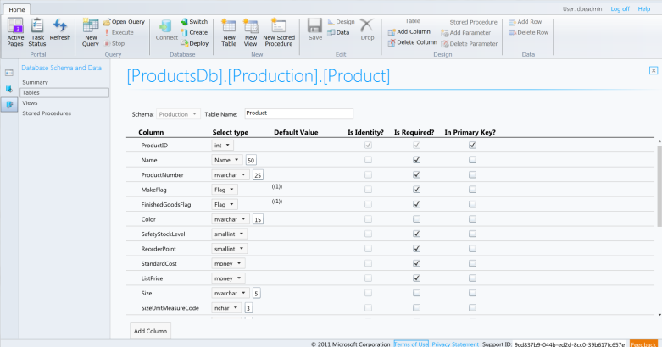
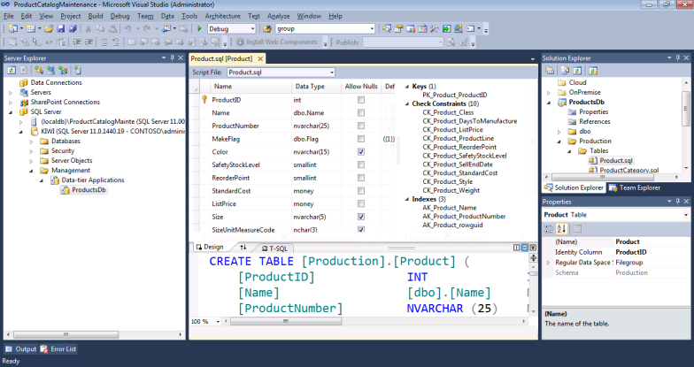
Build Your Database
Thin client database development
  Introducing the SQL Azure management portal
  Web designers for tables, views, stored procs
  Interactive query editing and execution
Rich client database development
  Introducing SQL Server Data Tools (SSDT)
  Visual Studio IDE for database development
  Includes modern designers and projects with declarative,
  model-driven development
  Develop and test in both connected and disconnected states
  Platform targeting for both SQL Server (2005 and above)
  and SQL Azure
  Get it free with Web PI, with SQL Server 2012 and with Visual Studio 11

Slide 11
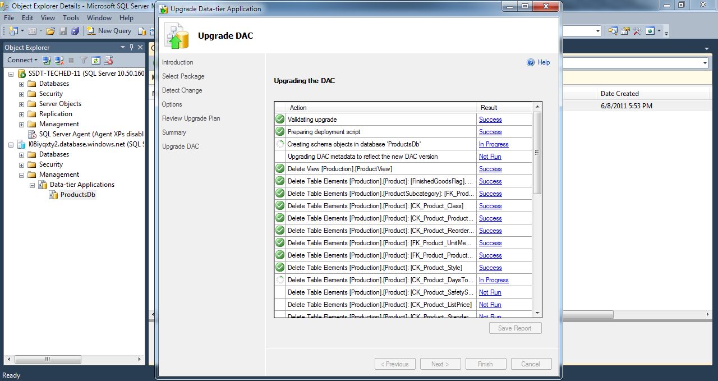
Deploy Your Database
Data-tier Application Framework
(DAC Fx)
  Alternative to traditional script based approach
  Dramatically simplifies deployment, migration and versioning of databases
  Provides a single unit of deployment for schema (dacpac) or for schema
  + data (bacpac)
  Supports automatic versioning of database schemas
  Supports platform targeting for both SQL Server (2005 and above)
  and SQL Azure
  Build from scratch or extract from existing db
How to get the latest DAC Fx
  With SQL Server Data Tools
  With SQL Server 2012 Management Studio
  With SQL Azure Import/Export Service
  Via sqldacexamples.codeplex.com

Slide 12
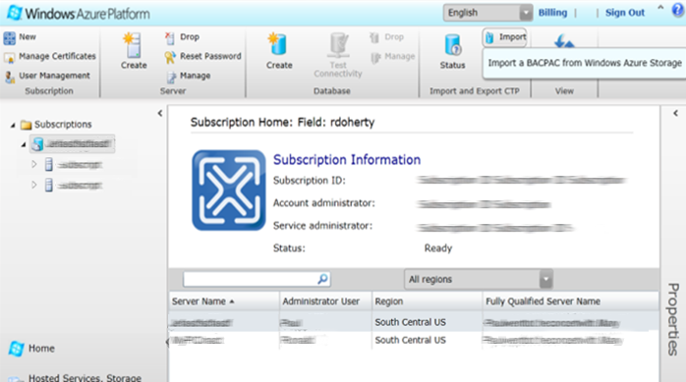
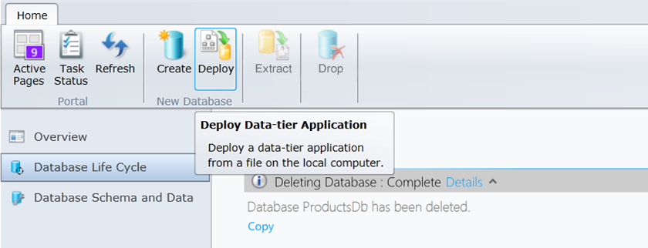
Deploy Your Database
Interactive approach for dacpac v1
and v2
  Manage your server with SQL Azure Management Portal
  Deploy dacpac
  Load data (scripts, bulk copy, SSIS)
  Also supported in SQL Server 2012 Management Studio
Interactive approach for bacpac v2
  Upload bacpac to blob storage
  Log into Windows Azure Management Portal
  Import bacpac, table data automatically loaded
  Also supports export to blob storage
Upgrading a dacpac or bacpac
  Not supported in portals yet
  Use SQL Server 2012 Management Studio

Slide 13
DAC deployment from Visual Studio
demo

Slide 14
Secure your
Database

Slide 15
There are two ways to secure a database:
On the Server
Within the Database

Slide 16
Benefits
Server identity and access control
  SQL authentication supported
  Integrated authentication not supported
  Connect to master to administer logins and create / drop databases
  The admin login (configured during service provisioning) is like sa
  The admin login has full rights on the server (and all databases) and should only be used for administration
  Manage logins with CREATE / ALTER / DROP LOGIN commands
  Membership in the loginmanager server role grants CREATE / ALTER / DROP LOGIN privileges
  Membership in the dbmanager server role grants CREATE / DROP DATABASE privileges

Slide 17
Benefits
Database identity and access control
  Logins must have an associated user account to connect to a database
  The admin login is automatically associated with a special user known as dbo (database owner)
  The dbo has full rights in the database and should only be used for administration
  Manage users with CREATE / ALTER / DROP USER commands
  Add users to system or user-defined database roles to grant privileges via sp_add_rolemember
  Organize database objects into schema containers based upon common access control requirements
  Grant privileges to schema containers instead of individual objects for better productivity

Slide 18
Connect Your Application
Connecting to SQL Azure
  TDS (Tabular Data Stream) protocol over TCP/IP supported
  SSL required
  Use firewall rules to connect from outside Microsoft data center
  ASP.NET EXAMPLE:
Special considerations
  Legacy tools and providers may require special format for login: [login]@[server]
  Idle connections terminated after 30 minutes
  Long running transactions terminated after 24 hours
  DoS guard terminates suspect connections with no error message
  Failover events terminate connections
  Throttling may cause errors
  Use connection pooling and implement retry logic to handle transient failures
  Latency introduced for updates due to HA replicas
  No cross-database dependencies, result sets from different databases must be combined in application tier
<connectionStrings>
<addname="AdventureWorks"connectionString=
"Data Source=[server].database.windows.net;
Integrated Security=False;
Initial Catalog=ProductsDb;
User Id=[login];
Password=[password];
Encrypt=true;"
providerName="System.Data.SqlClient"/>
</connectionStrings>

Slide 19
Exploring advanced Capabilities

Slide 20
Explore Advanced Capabilities
Rapid innovation
  Improved engineering efficiencies
  Quarterly service update cadence
  Improved operational agility
  Powerful new services
  Buy / sell finished data sets on the Windows Azure Marketplace
  Visualize data with SQL Azure Reporting
  Synchronize data with SQL Azure Data Sync
  Scale out data with SQL Azure Federations
New developer opportunities
  Devices connected to continuously available cloud services
  Consumer applications
  SaaS applications

Slide 21
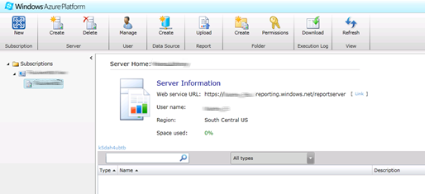
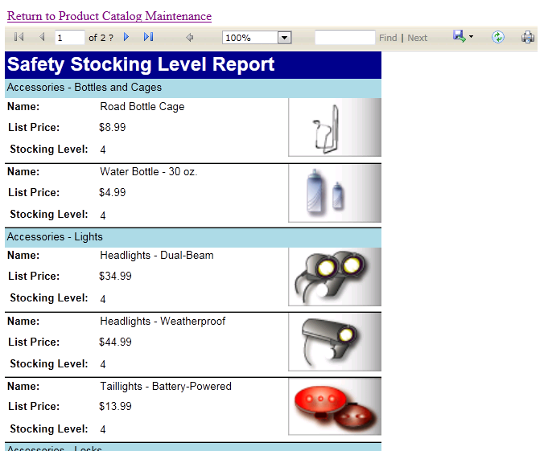
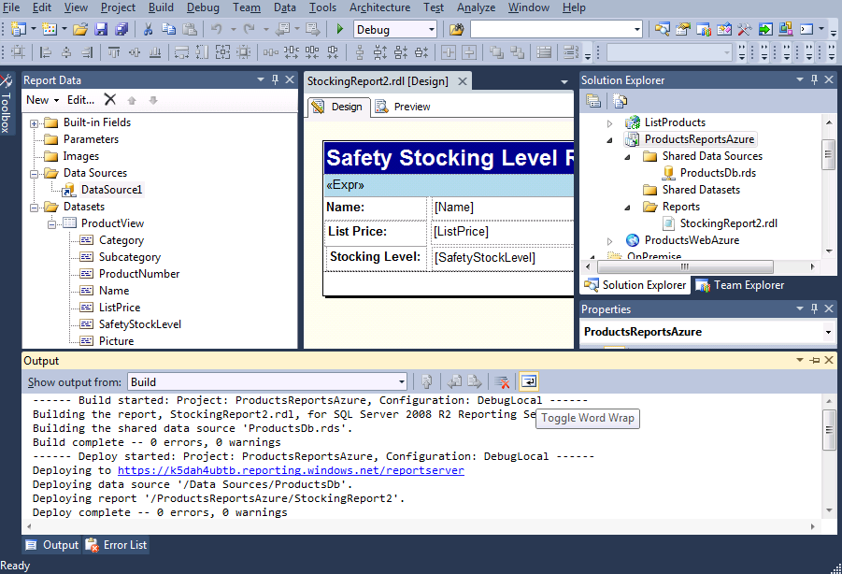
Visualize Your Data
SQL Azure Reporting is
  SQL Server Reporting Services technology delivered as a service on the Windows Azure Platform
  Ideal for operational reporting against SQL Azure data
  Enterprise-ready with automatic support for HA
  Designed to scale elastically with demand
  Get started quickly
  Provision report server via Windows Azure Management Portal
  Build reports with Reporting Services Report Designer
  Deploy reports to report server
  Render reports with Visual Studio ReportViewer controls

Slide 22
Visualize Your Data
Use familiar technologies
  Visual Studio Report Designer
  RDL (Report Definition Language)
  Report items and visualizations
  Report Server Web Service / URL access
  Visual Studio ReportViewer Control
Differences in comparison to Reporting Services
  Focus on logical vs. physical administration
  Report catalog and temporary database automatically provisioned
  Windows Azure Management Portal replaces Report manager
  SSL Required
  SQL Azure data sources only
Identity and access control
  SQL authentication supported
  (no support for integrated authentication)
  Admin user configured during provisioning
  Admin user has all rights on server, use for
  administration only
  Provision users using portal or web service
  Add users to appropriate item (Browser, Publisher)
  and system roles (User, Admin)
  Grant item-level permissions to folders or reports
Unsupported Reporting Services features
  Report Builder
  Subscriptions, schedules, caching
  Custom extensions
  Report models
  External images

Slide 23
SQL Azure Reporting Services
demo

Slide 24
Synchronize Your Data
SQL Azure (Hub)
SQL Azure (US)
SQL Azure (WE)
SQL Server (OnPrem)
SQL Azure Data Sync is
  Microsoft Sync Framework technology delivered as a service
  on the Windows Azure Platform
  Ideal for scheduling synchronization between data sets hosted
  in SQL Azure or SQL Server
  Uses a hub and spoke topology
  Special considerations
  Conflict resolution policy configured centrally (hub or client wins)
  Sync direction configured between each client and the hub
  (to hub, from hub, bi-directional)
  Sync schedule must be between 5 minutes and 1 month
  Data sets include multiple tables and can be filtered, triggers are added to data set tables
  Tables added to hub and client schemas
  Agent must be installed for on-prem clients

Slide 25
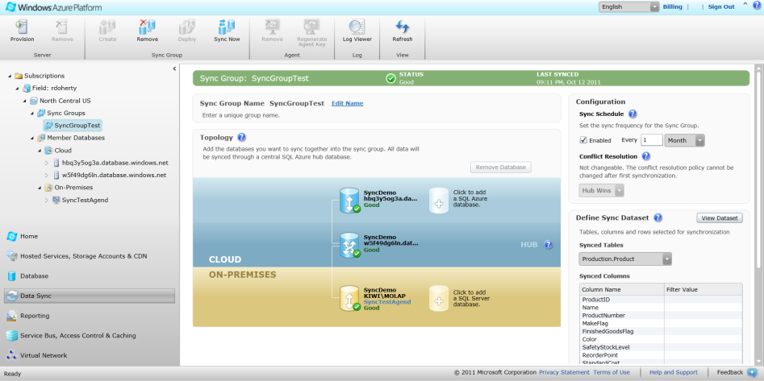
Synchronize Your Data
Provisioning synchronization groups
  Deploy database to hub and clients
  Set synchronization schedule
  Set conflict resolution policy
  Define data set
  Add SQL Azure clients to topology
  Install agents on SQL Server clients and add them to topology using keys
  Deploy topology
  Operational considerations
  Manual synchronization supported
  Hub updates require one synchronization to distribute to all clients
  Client updates require two synchronizations to distribute
  to all clients
  Sync Framework triggers may affect application behavior

Slide 26
SQL Azure DataSync
demo

Slide 27
Scale Out Your Data
SQL Azure Federations provides
  Integrated database sharding that can scale to hundreds
  of nodes
  Multi-tenancy via flexible repartitioning
  Online split operations to minimize downtime
  Automatic data discovery regardless of changes in how data is partitioned
  Special considerations
  A logical database can contain multiple federations
  Distribution scheme supports int, bigint, guid, and varbinary types
  Filtering routes connection to appropriate shard regardless of changes in partitions
  Merge, fan-out queries and automatic distribution of schema changes not supported in initial release
Federation Root
Multi-Tenant Db
Tenant 3 Db
Tenant 4
Tenant 1
Tenant 2
Tenant 4 Db 1
Tenant 4 Db 2

Slide 28
SQL Azure Federations
demo

Slide 29
Thank You

Slide 30
Appendix

Slide 31
SQL Azure Billing Rates (As of Feb 2011)
Web Edition
  $5.00 per database up to 100 MB per month
  $9.99 per database up to 1 GB per month
  $49.95 per database up to 5 GB per month
  Business Edition
  $99.99 per database up to 10 GB per month
  $199.98 per database up to 20 GB per month
  $299.97 per database up to 30 GB per month
  $399.96 per database up to 40 GB per month
  $499.95 per database up to 50 GB per month
Data Transfers
  North America and Europe regions $0.15 per GB out
  Asia Pacific region $0.20 per GB out
  All inbound data transfers are at no charge.

Slide 32
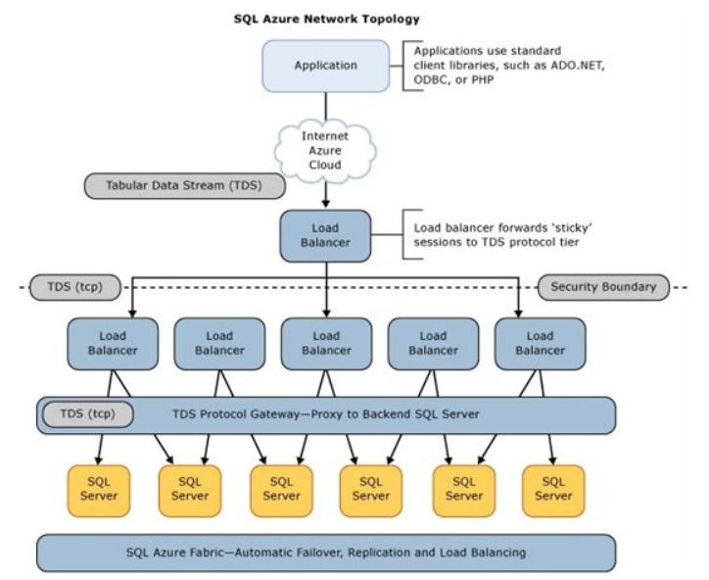
SQL Azure Database Architecture (As of October 2011)

